Slide 1
Healthcare Industry Key Business risks & emerging issues
A Hot Topics Discussion
August 2018

Slide 2
Today’s presenters
Richard is a founding member and Protiviti’s Global Healthcare Practice Leader. He has extensive experience providing operational, financial, and regulatory consulting and internal audit services to the healthcare industry. In addition to leading numerous business performance improvement and risk management initiatives, Richard has experience serving in roles such as Chief Audit Executive and Chief Compliance Officer for large integrated healthcare delivery systems. Prior to joining Protiviti, Richard was a Project Manager at Arthur Andersen and provided internal audit and business and technology risk consulting services to healthcare clients. Richard is a frequent speaker on internal audit, compliance, and revenue improvement initiatives.
Matt is a founding member of Protiviti and serves as Protiviti’s Healthcare Information Technology Solutions Leader. He is also responsible for leading Protiviti’s Digital Transformation initiatives for the healthcare industry. He has extensive experience providing operational, technology, and regulatory consulting and internal audit services to a wide range of healthcare organizations. He is a frequent speaker on internal audit, compliance, and information technology improvement initiatives. He has also published related pieces for national publications as well as various additional healthcare thought leadership resources.

Slide 3
What’s hot?
Regulatory Compliance, Reform & Policy
Revenue Recognition & Lease Accounting
Opioid Crisis / Drug Diversion
Revenue Cycle Optimization
Enterprise Risk Management
HIPAA Compliance & OCR Enforcement
Cybersecurity
Digital Transformation
EHR Implementation and Optimization

Slide 4
Enterprise risk management

Slide 5
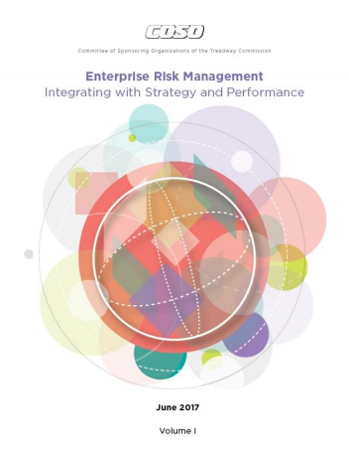
Risk & ERM defined According to Coso
“Risk is the possibility that events will occur and affect the achievement of strategy and business objectives.“
“Enterprise risk management is not a function or department. It is the culture, capabilities, and practices that organizations integrate with strategy-setting and apply when they carry out that strategy, with a purpose of managing risk in creating, preserving, and realizing value.”

Slide 6
erm study: Background
Protiviti and North Carolina State University’s ERM Initiative surveyed 728 board members and C-suite executives globally on risks likely to affect their organizations over the next year.
The survey provides perspectives on the potential impact of 30 specific risks across three dimensions:
Macroeconomic Risks
Likely to affect the organization’s growth opportunities.
Strategic Risks
Likely to affect the validity of the organization’s strategy for the pursuit of growth opportunities.
Operational Risks
Likely to affect key operations of the organization in executing its strategy.

Slide 7
ERM Study: healthcare Top risks for 2018
 | Rank | Risk Issue | YOY Trend
1
Rapid speed of disruptive innovations and new technologies – Rapid speed of disruptive innovations and/or new technologies within the industry may outpace our organization’s ability to compete and/or manage the risk appropriately, without making significant changes to our operating model.
2
Regulatory changes and regulatory scrutiny – Regulatory changes and regulatory scrutiny may heighten, noticeably affecting the manner in which our products or services will be produced or delivered.
3
Cyber threats – Our organization may not be sufficiently prepared to manage cyber threats that have the potential to significantly disrupt core operations and/or damage our brand.
4
Customer preferences – Shifts in social, environmental, and other customer preferences and expectations may be difficult for us to identify and address on a timely basis
5
Privacy/identity management and information security – Ensuring privacy/identity management and information security/system protection may require significant resources for us.

Slide 8
Regulatory Landscape

Slide 9
Regulatory Risk
U.S. Department of Health & Human Services-Office of Inspector General (HHS-OIG) reported expected recoveries of more than $4.13 billion, 881 criminal actions, 826 civil actions, and exclusions of ~3,200 individuals and entities from participation in federal healthcare programs for FY ‘17. Additionally, the Office for Civil Rights (OCR) has expanded the volume and rigor of proactive HIPAA compliance audits.
1
Opioid Crisis / Drug Diversion
2
Safeguarding PHI/ePHI
3
Program Effectiveness
4
Physician Arrangements
5
501r
6
Coding, Charge & CDM Integrity
7
Provider Based Billing
8
Government Overpayments
9
Targeted Probe & Educate Audits

Slide 10
Program effectiveness guidance
1
Federal Sentencing Guidelines
2
OIG Model Compliance Program Guidance
3
Affordable Care Act
4
Yates Memo
5
Boards of Directors Practical Guidance
6
DOJ Evaluation of Compliance Programs
7
Measuring Compliance Program Effectiveness

Slide 11
Corporate Tax Rate Reduction
Excise Tax on
Top Earners
American Patients First Initiative
Reform Highlights
VA Mission Act
ACA Costs
Telehealth
Opioid Abuse
Medicare Appeals

Slide 12
Revenue Cycle Optimization

Slide 13
A key concern for most providers today is being able to maximize the revenue received for the services they provide.
Ineffective or inefficient internal controls for key revenue cycle processes can affect the organization’s net revenue and margins.
One of the best indicators to help determine the effectiveness of a provider’s revenue cycle is to look at denied (and rejected or underpaid) claims!

Slide 14
cybersecurity

Slide 15
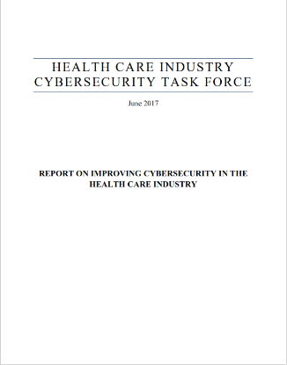
Improving cybersecurity
Health Care Industry Cybersecurity Task Force
“Report on Improving Cybersecurity in the Health Care Industry”
Cybersecurity Act of 2015
Multi-Stakeholder Task Force
Identify cybersecurity issues and develop recommendations

Slide 16
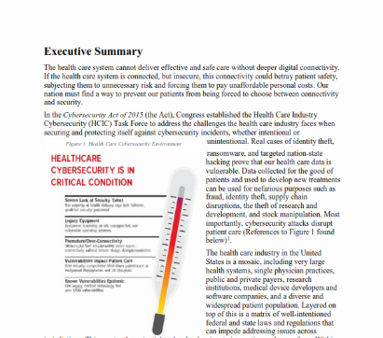
State of the industry
Healthcare Cybersecurity is in “Critical Condition”
Severe Lack of Security Talent
Legacy Equipment
Premature/Over-Connectivity
Known Vulnerabilities Epidemic
Vulnerabilities Impact Patient Care
38 vs. 19
“Patient Safety” vs. “Patient Privacy” references

Slide 17
Reality of today
Trending Risk Areas
IT Vendor Management
Medical Devices
The Internet of Things (IoT)
Vulnerability Management
Business Continuity / Disaster Recovery
User Authentication / Passwords
Social Engineering
Ransomware
Increasing reliance on technology / connectivity
Ever-changing threat landscape
Intensifying regulatory scrutiny

Slide 18
HIPAA & ocr enforcement

Slide 19
Snapshot
257,738,185
Patients Impacted
2,000
# of reported breaches
4 out of 5
records breached from hacking / IT incident

Slide 20
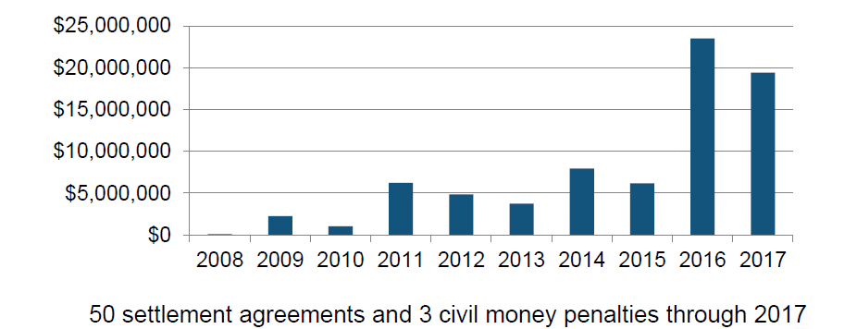
HIPAA resolution agreements & Civil Money penalties
Source: Office for Civil Rights: A HIPAA Compliance and Enforcement Update Session #24 HIMSS18 – Roger Severino, Director, HHS Office for Civil Rights

Slide 21
OCR’s continuing enforcement issues
Incomplete or Inaccurate Risk Analysis
Failure to Managed Identified Risk
Lack of Business Associate Agreements
Mobile Device Security
Lack of Transmission Security
Lack of Appropriate Auditing
Patching of Software
Insider Threat
Disposal of PHI
Insufficient Backup and Contingency Planning
Source: Office for Civil Rights: A HIPAA Compliance and Enforcement Update Session #24 HIMSS18 – Roger Severino, Director, HHS Office for Civil Rights

Slide 22
Digital Transformation

Slide 23
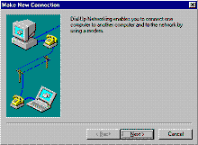
Digital transformation
2010s & Beyond – Peer to Peer Business, Smart Devices, Blockchain, Digital Currencies
Over the past half century, technological advancements have dramatically changed the way we live and interact. The internet made the world flat, sped up the flow of information, and spawned new ways to do business, but that was just the beginning…
2000s – Emergence of Mobile Computing
1990s – Emergence of the Internet
1970s – First Personal Computers
Major Leaps in Technological Innovation
Digital Transformation is an end-to-end perspective and perpetual, cumulative evolution of integrating the latest technologies for continuous improvement of an organization’s core business and how they service their customers.

Slide 24
Digital transformation (cont.)
Where Do Organizations Sit On The Digital Maturity Scale
Skeptic | Beginner | Follower | Advanced | Leaders
Financial Services
Hospitality
High
Technology
Fast Moving Consumer Goods
Telecom
Retail
Automotive
Energy & Utilities
Manufacturing/IP
Pharmaceuticals & Healthcare
PROTIVITI’S DIGITAL MATURITY SCALE
1
2
3
4
5
6
7
8
9
10
Digital Skeptic
Digital Beginner
Digital Follower
Digital Advanced
Digital Leader
Digital plans are not formalized and initiatives are managed in an ad-hoc or reactive manner.
Digital plans are not fully developed although multiple digital initiatives are underway and the objectives of these initiatives are understood.
A digital strategy has been developed and the organization has a proven track record delivering on digital initiatives. Digital initiatives are typically focused on discrete aspects of Customer Journey.
Digital aspects are in place and managed quantitatively enterprise wide. High levels of process automation have been achieved. The organization has a proven track record adopting emerging technologies.
Organization has a proven track record of disrupting traditional business models. Digital aspects of strategic plans are continually improved based on lessons learned and predictive indicators.

Slide 25
Digital transformation (cont.)
Etc.
The Internet of Things (IoT)
Telehealth
Artificial Intelligence /
Cognitive Computing
Virtual Care
Biosensors
Risk
Etc.
3D Printing
Robotic Process
Automation
Virtual Reality
Social Media
Wearables
Etc.
Blockchain
Etc.
Data / Advanced Analytics
Genomics

